Slide 1


Orientation &
Notes Training
Prepared by: Corey Goheen, Foster Care Case Manager
Wil La Mootk Therapeutic
Foster Care

Slide 2

Continuum of Care
*Outpatient
*Home Based
*Therapeutic Foster Care (treatment fc, resource, specialized or treatment foster care out of home tx, etc)
Residential
Acute Care

Slide 3
Wil la mootk Foster Parent Training
-25 hours per parent annually: topics outlined on Wil la mootk Foster Care Training Checklist form. WLM Training Checklist and Signature Page.docx
-initial orientation for new tfc provider

Slide 4
Types of Therapeutic Foster Care
Behavioral Health********-WLM offers this one.
Ex – SED diagnosis, officially meets criteria as specified on assessment tools and during Wil la Mootks new matching and screening process.
Medicaid Waiver
CCMC
Ex-
DID
Ex -
Rural Deaf
Attends the School for the Deaf
Youth has a mental health diagnosis impacting youth’s ability to maintain safety in multiple environment. May demonstrate verbal and/or physical aggression, suicidal ideation, self-harm, need support around adaptive living skills, etc.

Slide 5
TFC vs. Traditional Foster Care
Therapeutic Foster Care
Initial Training/Orientation- 25 hours each parent. Training focuses on trauma informed practices necessary to meet the needs of youth impacted by trauma, mental health concerns, neurodevelopmental differences, and/or complex medical needs
Expectations – WLM parents provide therapeutic interventions to assist youth to develop resilience skills necessary to maintain safety, health and well-being in all social domains: emotional and physical safety and health.
Goal - To be discharged into outpatient services in either the family of origin or an adoptive placement or continue to gain life skills toward independent living, if possible
Wil la Mootk has adopted the Pressley Ridge curriculum which is evidenced based
Traditional Foster Care
Initial Training - focuses on introduction to the Child Protection System, licensing regulations, impacts of abuse and neglect, typical child development, & parenting strategies
Expectations – provide a safe and loving home environment where the children’s basic needs are met
Goal – Permanency hopefully reunification with parents, if not adoption

Slide 6

What services can be supportive around in TFC?
Children with Complex Medical Conditions
Care Coordination
Day Habilitation
Respite
Supported Employment
Environment Modifications and/or Specialized Medical Equipment
Nursing Oversight & Care Management
Intellectual & Developmental Disabilities
Care Coordination
Day Habilitation
Respite
Supported Employment
Behavioral Health- WLM services!
Case Management
Individual Therapy
Family Therapy
Skill Building (Individual, Family and/or Group)
Medication Management

Slide 7
An out-of-home alternative placement for children who can no longer live at home due to a variety of reasons:
The primary families inability to manage a youth’s emotional and behavioral challenges which require a higher level of care. (Private or Voluntary Placements)
Youth in OCS care who need a higher level of care than traditional foster care due to emotional and behavioral challenges.
Youth who may have been in residential treatment facilities or hospitalized and are stepping down from care with the intention of continuing to develop safety in a community setting, before returning to permanent home
Witnessed or experienced traumatic events – on average 4 or more Adverse Childhood Experiences (ACEs)

Slide 8
Reasons for alternative placements, continued.
Emotional and behavioral problems – mental health diagnosis, suicidal ideation, self-harm
Special needs; learning and/or developmental disabilities, FASD, ASD
Poor functioning at home, school, community; delinquent behavior – running away, truancy, physical aggression,
Multiple placements – multiple foster home placements, acute hospitalizations and RTC treatment stays

Slide 9
Alaska Treatment Foster Care
--By the Numbers (2021 statistics-need update)
Number of Homes by Region
Anchorage 87
Mat-Su 50
Kenia 3
Fairbanks 19
Southeast 28
Total Number of youth in TFC : 181
Number of male 110
Number of female 71
Age range
Male majority age range 7 to 14 yrs. old
Female majority age range 11 to 15 yrs. old

Slide 10

Characteristics of a Successful Therapeutic Parent
Dedicated, compassionate, flexible people who are willing to take on responsibilities expected of any parent, plus the challenges of supporting youth with complex emotional and behavioral problems and/or complex medical needs and/or developmental disabilities.
Being able to work with professionals who are part of the youth’s treatment team
Responsible Law-Abiding Citizen
Team Player
Clear Communicator using both written words and verbal communication (write the notes)

Slide 11
Characteristics, Continued
Active and Adaptive Learner: People who are wanting, willing, eager to learn- not just from us, but from and about our youth
Ability to self-regulate in situations of complete chaos
Reliable and Dependable
Organized
Ability to work with individuals from all walks of life
Otherwise financially stable/ income supporting the family that is not dependent on therapeutic fostering stipend

Slide 12
Additional Requirements of TxP
More in depth home study
More in-depth and targeted training
Additional reporting requirements
Monthly in home support and training
Additional requirements due to the Agencies own internal policies and expectations of their accrediting body.
Cannot hold a license with multiple foster care agencies
Living environment that can support the needs of the youth

Slide 13
Wil la mootk Therapeutic Foster Note Template/ Example
..\CPA Application Process\Forms\Notes Template.docx (Draft)
Identify the goal number (s) you addressed writing the number of goal carried directly over from their individualized person-centered treatment plan- (ex:2,3) write goal number.
Then, pick 2 categories from the implied interventions to write a minimum of 2 sentences describing what YOU did to help them today be more successful and resilient.
Check how they responded best- Describe in two sentences how they responded to your interventions.
Make sure all dates match on the note.
Sign your name!
Example: Jane Do: Lets practice now! Provide Scenario:___)

Slide 14

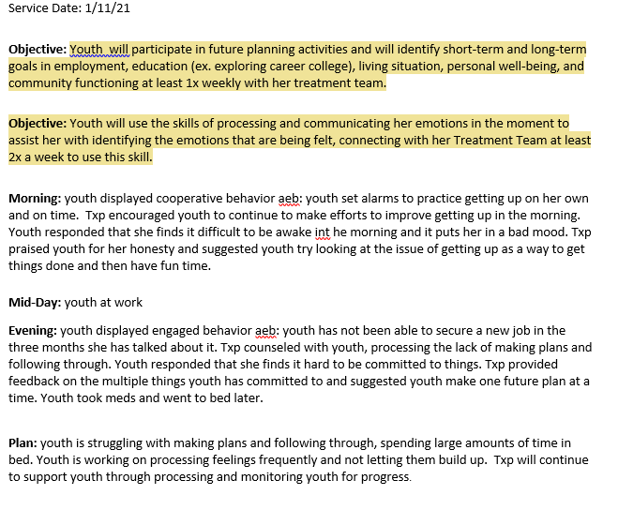
Add in a “Sample Note”

Slide 15
Common Interventions in a “Progress Note”
Some examples of words to capture all of the good interventions you are providing in your home include:
· proximity control
· role modeling
· coping role modeling
· reflective listening
· coaching
· pre-teaching
· shaping positive behaviors
· praise, encouragement
· redirection · teaching how to use self affirmations · logical consequences · limit setting · natural consequences · selective ignoring · house rules · verbal and written contracts · rituals of care · group (family) activities · accountability checks · sight and sound supervision · teaching social skills · teaching independent living skills · prompting · giving cues · ABC plan · behavior chart · fading · positive reinforcement · differential reinforcement of alternate behaviors · fading · problem solving · confrontation · I feel statements · victim mediation · reality testing · refocusing · reframing · adventure based activities · goal setting · nonphysical de-escalation · money management

Slide 16
What therapeutic intervention did YOU provide and how did they respond?
What interventions did you provide to target which goals on the treatment plan?
How did they respond?

Slide 17
Other Helpful Hints-TFC Parent Tip Sheet
Notes training-TFC Parent Documentation Tip Sheet Final.pdf
Helpful possible interventions and words-
· proximity control · role modeling · coping role modeling · reflective listening · coaching · pre-teaching · shaping positive behaviors · praise, encouragement · redirection · teaching how to use self affirmations · logical consequences · limit setting · natural consequences · selective ignoring · house rules · verbal and written contracts · rituals of care · group (family) activities · accountability checks · sight and sound supervision · teaching social skills · teaching independent living skills · prompting · giving cues · ABC plan · behavior chart · fading · positive reinforcement · differential reinforcement of alternate behaviors · fading · problem solving · confrontation · I feel statements · victim mediation · reality testing · refocusing · reframing · adventure based activities · biblio-theraphy · goal setting · urine analysis · MAB · nonphysical de-escalation · money management TFC Handbook Rev 5-20-09 28 · budgeting · tutoring · processing feelings · assisting in keeping an anger log · 1-2-3 magic (as guided and recommended by the childs’ clinician and team · contingency planning · use of primary and social reinforcement · family meeting · distraction · side talk · tracking antecedents · behavioral tracking · offering positive alternatives · physical guidance · CATCHING THE CHILD DOING GOOD 90% of the time · memory book · letter writing · magic box · cookie jar (giving written compliments and storing them in a place where child can review or go for comfort in crisis, gradually learning to give self affirmations) · play · humor · companion chores · success chart · broken record in limit setting · separating behavior from feelings about the child when limit setting · cueing for self-control · setting a sterile environment · challenging thinking errors

Slide 18

Benefits of TFC
Continued training is important to help children who have experienced trauma become more resilient and can lead to a more successful outcome.
WLM staff is here to support you- call Corey (Foster Care Case Manager) or the Wil la Mootk Treatment Team assigned to child depending on the situation for help!
Work collaboratively with others as an integral part of the team
Youth has an agency case manager in addition to their OCS staff to advocate on behalf of the youth and help coordinate services
Therapeutic Parents receive a licensing supervisor from the agency that provide support and coaching-Corey Goheen (907)401-1242
Youth and Treatment Parents may be able to access respite care
On-Call support during times of crisis
Additional financial compensation to meet the needs of the youth
Additional training to meet the specific needs of the youth

Slide 19

Greatest Need for Therapeutic Parents
Those willing to work with Teens
Those willing to work with parenting and/or pregnant teens
Those willing to work with youth involved in the juvenile justice system
Those willing to support LGBTQ+ youth
Those able to support youth with sexualized behaviors
Those able to tolerate and remain calm when a youth demonstrates aggressive behaviors
Those who have specialized training or would be willing to have specialized training to support youth with Complex Medical Needs to include: Diabetes, Seizure Disorder, and physical and/or medical disabilities requiring specialized equipment

Slide 20
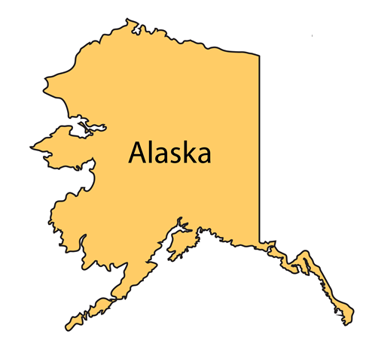
Child Placement Agencies (CPAs)
Across the State
Anchorage
  AK Child & Family
  The Arc of Anchorage
  Anchorage, Mat-Su, Kenai & Kodiak
  Hope Community Resources
Anchorage & Mat-Su Valley
  Denali Family Services
  Shine Bright Care
Mat-Su & Fairbanks
  Family Centered Services of Alaska
  Presbyterian Hospitality House
Fairbanks
  Fairbanks Resource Agency
Kenai
  Kenai Peninsula Community Care Center
Southeast
  Prince of Wales & Ketchikan
    Community Connections
  Ketchikan
    Residential Youth Care
  Juneau
    Juneau Youth Services
    Akeela
  Sitka
    Youth Advocates of Sitka
  Metlakatla-Wil La Mootk Counseling Center

Slide 21

Panel Discussion
What has been your largest challenge?
What are the support and resources you receive as a TxP? How has this helped you in supporting the youth in your home?
Tell us about those notes?
Tell us about the youth who really “got to you”?

Slide 22

Your Turn…

